Slide 1
Artificial Neural Networks

Slide 2
Outline
Introduction
Analogy to human’s neuron
Role in AI and research
Advantages of neural networks
Perceptron and Neural Networks
Linear combination and activation function
Hidden layers
Output layers
Loss Function
Hyperparameters
Implementation in Python
Consideration
Overfitting

Slide 3
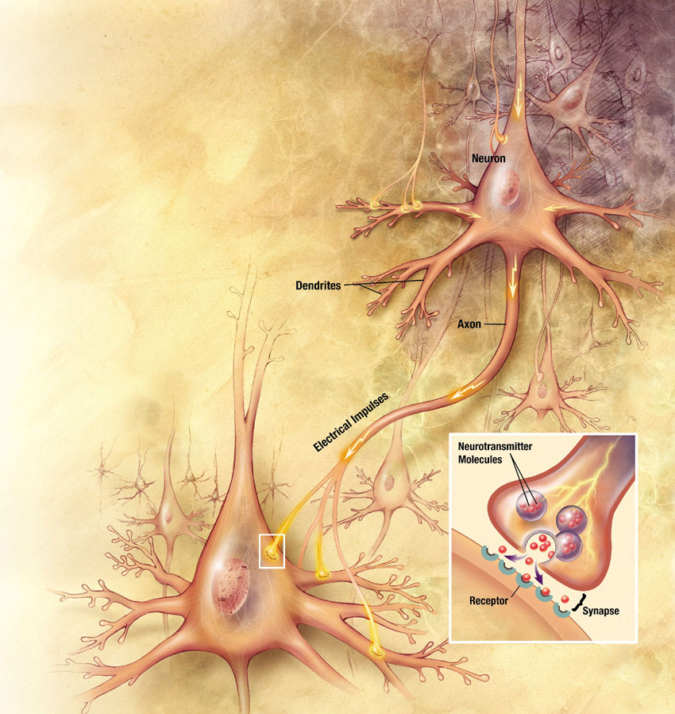





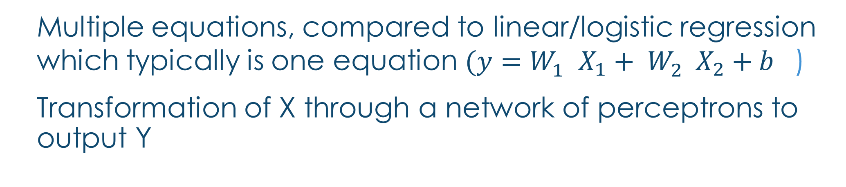
(Artificial) Neural Networks
Introduction
Neural
Network
X
Y
Multiple equations, compared to linear/logistic regression which typically is one equation $({y=W}_{1}^{}X_{1}+ W_{2}^{}X_{2}+b^{}$)
Transformation of X through a network of perceptrons to output Y
https://web.archive.org/web/20070713113018/http://www.nia.nih.gov/Alzheimers/Publications/UnravelingTheMystery/Part1/NeuronsAndTheirJobs.htm
Illustrator: Christy Krames, MA, CMI, for US National Institutes of Health, National Institute on Aging
Notes:
Neural network is mimicking what we understood about human neuron. ANN in research papers
So one neuron may gather all the stimulus/activation (parallel to X, summing up the features), then inside the neuron, some chemical reactions happen (activation functions which we do something on the summation) then output an activation, which in turn feeds into the next neuron
Artificial neural networks model mathematical functions that map inputs to outputs based on the structure and parameters of the network.
I will go into details of architecture latter
You can see the network part is like the logistic/linear regression, just that it is more complicated and may take on multiple equation.

Slide 4
Neural Networks in AI and research
Introduction
Building blocks of deep learning that underlies various AI application:
Computer vision, speech recognition, text
Autonomous driving: recognition of pedestrians and road conditions
ChatGPT, chatbot, Alexa, Siri: language comprehension and generation
Diagnosis of medical conditions: prediction based on image analysis of X-ray or mammograms, as well as other patients’ characteristics
Recommender system: prediction of users’ preferences based on their behaviours like clickstream etc
Neural networks are used in (academic) research for prediction and modelling:
Predicting age based on DNA sample for crime investigation (Thong et al, 2021)
Predicting social comparison effects among female Instagram users (Jabłońska & Zajdel, 2019)
Notes:
We won’t go into the deep learning in this course, but we will have offer in the future.

Slide 5
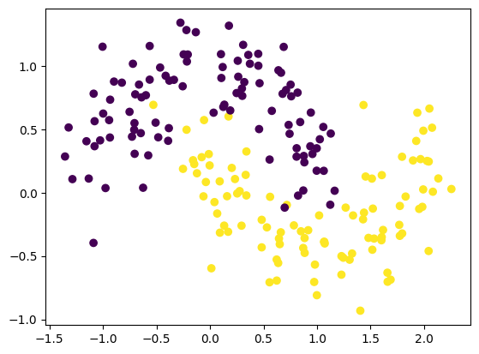
Why neural network?
Introduction
Input/features/X
Allows unlimited numbers of features for input.
Can handle complex tasks such as image, audio, video, text analysis
No assumption of linearity and distribution of data is required
Computing power
Use of GPUs and parallel processing that accelerate computations
Accuracy
Accuracy is generally improved with increasing amount of data with more complex neural network modelling
Notes:
Theoretically, multiple neurons (transformation) and layers are allowed to fit the data, and more complex model increases the accuracy. We will get a better idea as we go through the structure of the neural network.

Slide 6
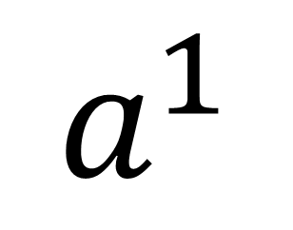
Perceptron
Architecture
$$a^{1}$$
Sum up input
Activation function
(Transformation)
$${g(W}_{1}^{1}X_{1}+ W_{2}^{1}X_{2}+..{W_{m}^{1}X}_{m}+b^{1})$$
Notes:
A neuron consists of 2 parts – Summation & activation
So one neuron may gather all the stimulus/activation (parallel to X, summing up the features), then inside the neuron, some chemical reactions happen (activation functions which we do something on the summation) then output an activation, which in turn feeds into the next neuron
The name neural network originally derived from thinking of these hidden
units as analogous to neurons in the brain — values of the activations
Ak = hk(X) close to one are firing, while those close to zero are silent
(using the sigmoid activation function).

Slide 7








Perceptron within neural network
Architecture
Input layer
Hidden layer
Layer 1
Output layer
Perceptron is the unit in hidden layer and output layer.
Perceptron can receive input from input layer (X) or output (a) from perceptron of the previous layer.
Input layer consists of variables/features.
$$X_{1}^{}$$
$$a_{1}^{}$$
$$X_{2}^{}$$
$$a_{2}^{}$$
$$y_{}^{}$$
$$X_{3}^{}$$
$$a_{3}^{}$$
$$X_{4}^{}$$
Two-layer neural network
- one hidden layer and output layer
Notes:
But some people call it single layer

Slide 8
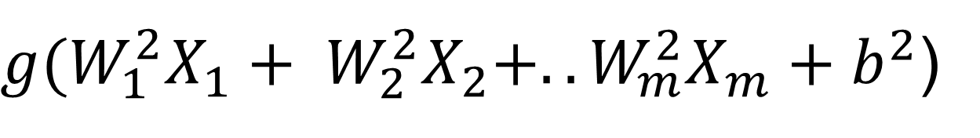






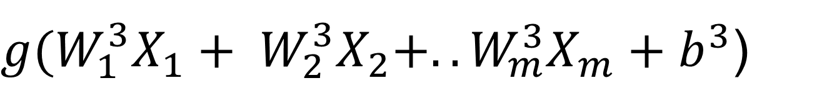
What does a perceptron do in each layer?
Optional material
Linear combinations of input
Activation function
(non-linear)
Output
$$X_{1}^{}$$
$$W_{1}^{1}X_{1}+ W_{2}^{1}X_{2}+..{W_{m}^{1}X}_{m}+b^{1}$$
$${g(W}_{1}^{1}X_{1}+ W_{2}^{1}X_{2}+..{W_{m}^{1}X}_{m}+b^{1})$$
$$a_{1}^{1}$$
$$X_{2}^{}$$
$$W_{1}^{2}X_{1}+ W_{2}^{2}X_{2}+..{W_{m}^{2}X}_{m}+b^{2}$$
${g(W}_{1}^{2}X_{1}+ W_{2}^{2}X_{2}+..{W_{m}^{2}X}_{m}+b^{2}$)
$$a_{1}^{2}$$
….
$$W_{1}^{3}X_{1}+ W_{2}^{3}X_{2}+..{W_{m}^{3}X}_{m}+b^{3}$$
${g(W}_{1}^{3}X_{1}+ W_{2}^{3}X_{2}+..{W_{m}^{3}X}_{m}+b^{3}$)
$$a_{1}^{3}$$
$$X_{m}^{}$$
What happens in each peceptron in the layer:
1st step: sum up the features with weight W (W for each feature and each perceptron differ, and is determined during the training
2nd step: the summation is then transformed via g (activation function), which is normally the same non-linear function across the three perceptrons.
Input layer with m features
Hidden layer with 3 perceptrons
Notes:
Perceptron is the building block of neural network and consisted of a linear and non linear components.

Slide 9
Example – Predicting learners’ engagement
Architecture
Example – Predicting learners’ engagement
Input layer
Hidden layer
Layer 1
Output layer
Length of video
contains story telling?
Number of learners completing the video
Instructor’s face is shown
Words spoken per minute
Notes:
The value of hidden layer and output layer is computed in the machine learning rather than already existed in your data.

Slide 10










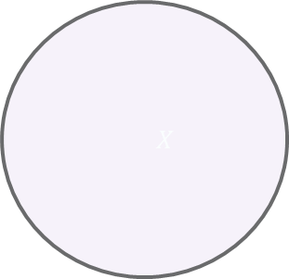



Perceptron within neural network
Architecture
Input layer
Layer 1
Layer 2
Output Layer
$${}_{}X$$
$$a_{1}^{2}$$
$$X_{1}^{}$$
$$a_{1}^{1}$$
$$a_{2}^{2}$$
$$X_{2}^{}$$
$$a_{2}^{1}$$
$$a_{1}^{3}$$
$$y_{}^{}$$
$$X_{3}^{}$$
$$a_{3}^{2}$$
$$a_{3}^{1}$$
There can be more than one hidden layer.
$$a_{4}^{2}$$
$$X_{4}^{}$$
Notes:
I put the activation notation inside the node just to avoid the messiness.

Slide 11








Perceptron within neural network
Architecture
Layer 1
Layer 2
Output Layer
Input layer
Layer 1
Layer 2
Output Layer
$${}_{}X$$
$$a_{1}^{2}$$
$$a_{1}^{3}$$
$$X_{1}^{}$$
$$a_{1}^{1}$$
$$a_{2}^{2}$$
$$a_{2}^{3}$$
$$X_{2}^{}$$
$$a_{2}^{1}$$
$$y_{}^{}$$
$$a_{3}^{3}$$
$$a_{3}^{2}$$
$$X_{3}^{}$$
$$a_{3}^{1}$$
$$a_{4}^{3}$$
$$a_{4}^{2}$$
$$X_{4}^{}$$
There can be more than one perceptron in output layer.
Notes:
I will also mention DENSE layer on this slide

Slide 12




Forward propagation
Architecture
$$X_{1}^{}$$
or
$$X_{2}^{}$$
….
$$y_{}^{}$$
….
….
….
$$X_{m}^{}$$
….
Input layer
Hidden layer(s)
Output Layer

Slide 13
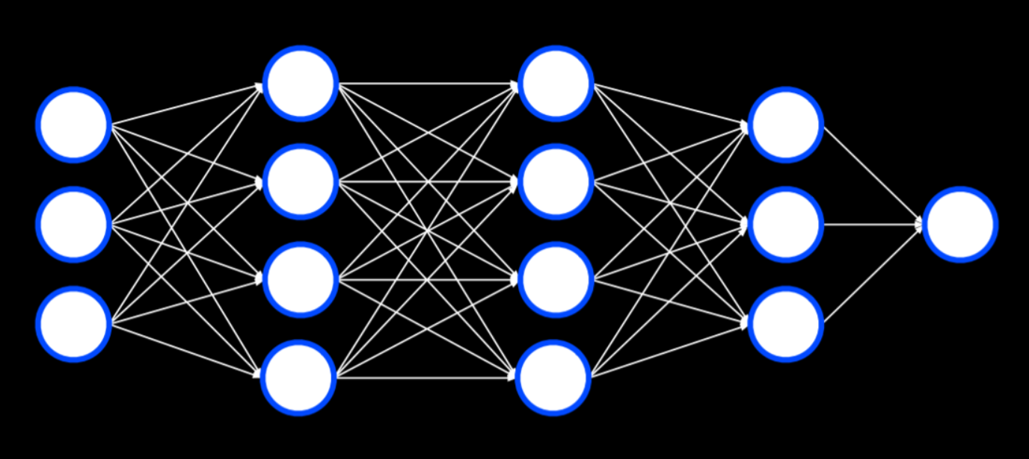
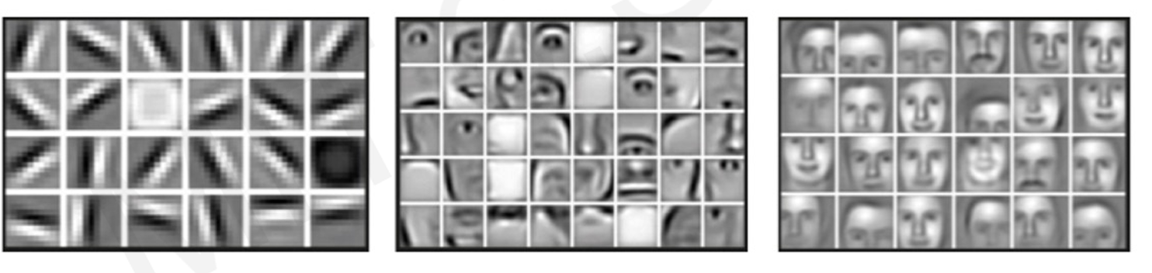
Intuition
Hidden Layers
Architecture
X (Input Layer)
Layer 1
Layer 2
Layer 3
Y(Output Layer)
Pixels of images
Honglak Lee, Roger Grosse, Rajesh Ranganath, and Andrew Y. Ng. 2009. Convolutional deep belief networks for scalable unsupervised learning of hierarchical representations. In Proceedings of the 26th Annual International Conference on Machine Learning (ICML '09). Association for Computing Machinery, New York, NY, USA, 609–616. https://doi.org/10.1145/1553374.1553453
Notes:
neural networks can learn non-linear relationships so you can opt to skip adding polynomial features
Each layer produces some high level features
Although this is based on a more sophisticated network, it does show that each layer combine feature into recognition of faces, how each layer add to more sophistication
For example, layer 1 seems to combine the pixels into edges, with each perceptron in the layer producing edges of different orientations.
The layer 2 receives all these edges and turns them into parts of human faces, with each perceptron producing different parts.
The layer 3 then combine all these parts into human faces, and output to decide whether it is a female or male face.

Slide 14
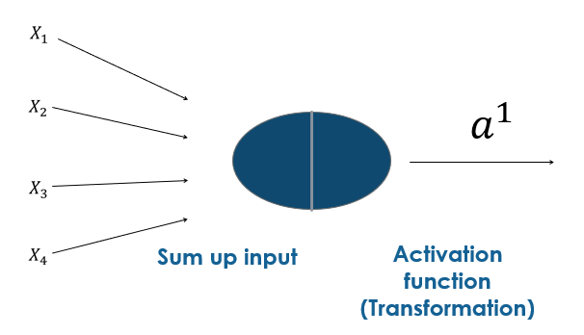
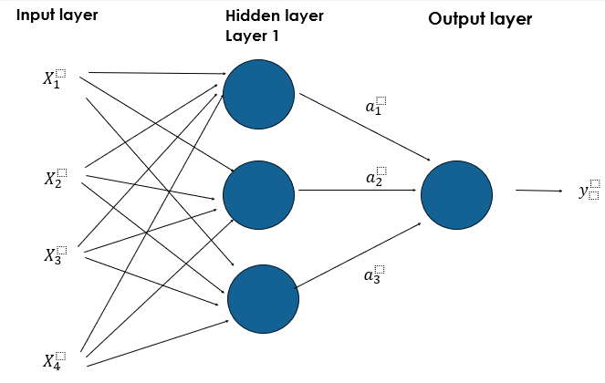
Hidden layer
Summary
Each perceptron in the same layer will have different summation (W) of the features, which is determined by the machine during the training.
The summation is then transformed through activation function. Typically, the same activation function is used for each perceptron in the same layer. The function is non-linear.
With these two characteristics, the network could build up fairly complex transformations of X that could model non-linear data and complicated data distribution.
In theory, there could be unlimited hidden layers and units in each layer.
Notes:
The different summation is due to different w and b.
It is called hidden layers because their values do not exist in our datasets.
We will talk about the caveat of number of hidden layers and units later

Slide 15







The effect of hidden layers and perceptron
Demo
http://playground.tensorflow.org/
Which data set do you think require a neural network to do a classification?
$$X_{1}^{}$$
$$X_{1}^{}$$
$$X_{2}^{}$$
$$X_{2}^{}$$
Notes:
Which
I will Demo for the effect of adding hidden layers, from without hidden layer and slowly increase the hidden layer and number of perceptron.
Try one layer than increase number of neurons until it does not impact, then add one more layer. But don’t do one neuron in the first layer (it means one output and it is like a bottleneck
Also use it to show that if activation function is linear… then it won’t account for non-linear patterns
The right one can be achieved with one hidden layer with 4 neurons
Demo reference
https://cs50.harvard.edu/ai/2023/weeks/5/

Slide 16
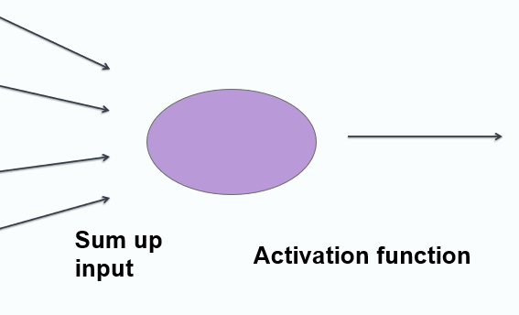
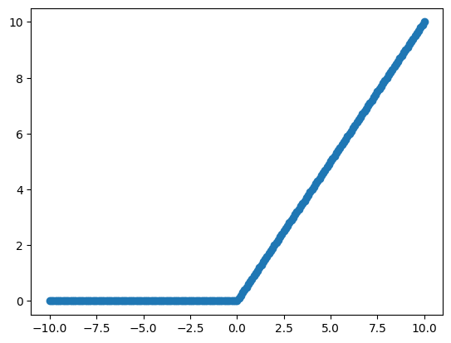
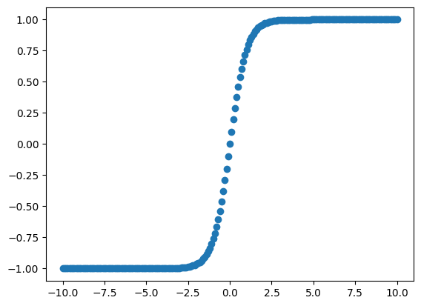
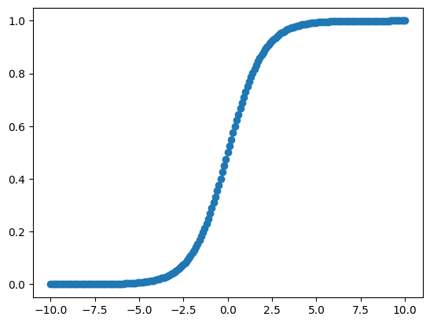
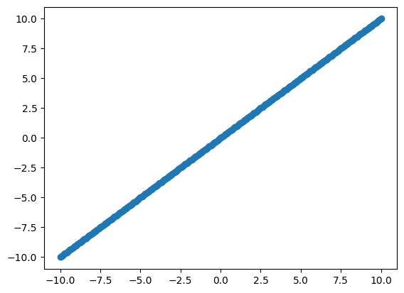
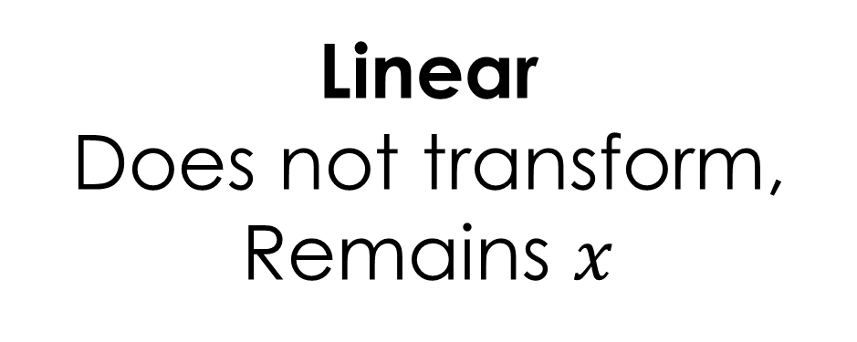
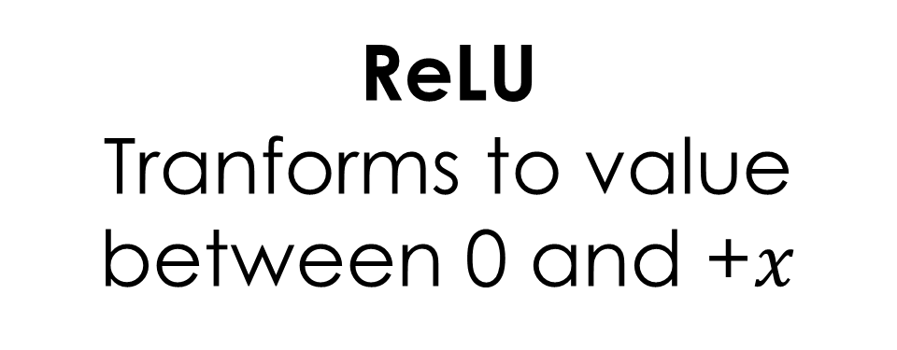
Activation function for hidden layers
Hidden layer
Transformation of the summation of input features
Introduces non-linearity into the network.
A ReLU activation is recommended as it can be computed and stored more efficiently than a sigmoid activation
https://www.tensorflow.org/api_docs/python/tf/keras/activations
$${g(W}_{1}^{1}X_{1}+ W_{2}^{1}X_{2}+..{W_{m}^{1}X}_{m}+b^{1})$$
ReLU
Tranforms to value between 0 and +$x$
Tanh
Tranforms to value between -1 and +1
Sigmoid
Tranforms to value between 0 and +1
Linear
Does not transform,
Remains $x$
Notes:
The relu cuts off values below zero, while tanh
saturates to –1 for low input values and +1 for high input values.

Slide 17
Output layer – 1 perceptron
Output layer
Similar to hidden layer, each perceptron in output layer will have summation of the activation received and transform the summation with an activation function.
Both activation functions and numbers of perceptron in the output layer depends on the task.
Sigmoid function outputs probability of the predicted class in a binary classification tasks
e.g., benign vs. malignant tumour
Linear function outputs the summation without any transformation for a regression task.
e.g., predict students’ score
Notes:
Explain sigmoid function output between 0 and 1. for probability >0.5, it is class one, else another class.

Slide 18
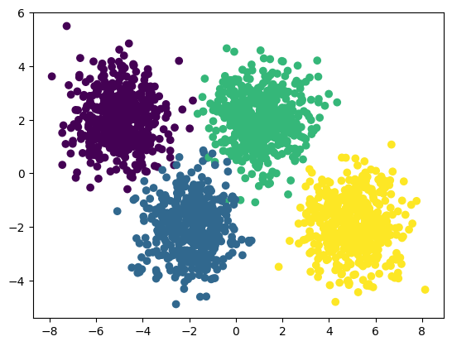
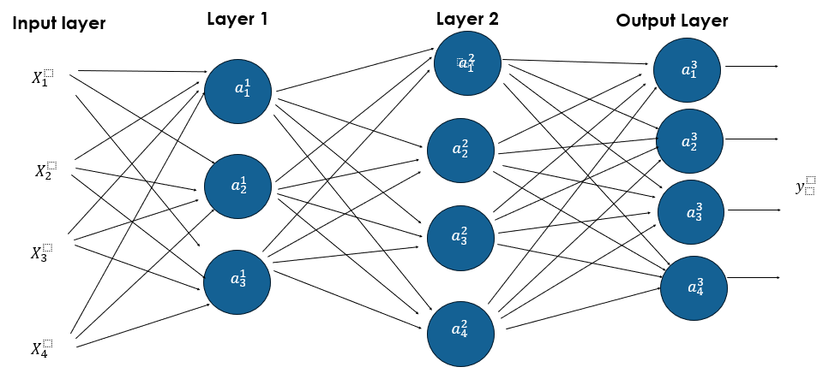

Output layer – Multiple perceptrons
Output layer
Multi-class classification task of more than 2 mutually exclusive classes. For example, a model predicts whether a patient has one of the four thyroid-related disorder.
Softmax function as the activation function of the perceptrons of the output layer, churning out probability of the case in each category, with the probability summing up to 100%. The case is assigned the category with the highest probability.
Example case
Probability of having Hyperthyroid
Probability of having Hypothyroid
Probability of having Euthyroid-sick
Probability of having Euthyroid
0.23
0.16
0.06
0.55
$$✓$$
Notes:
The softmax spans multiple output

Slide 19


Output layer – Multiple perceptrons (optional)
Output layer
Multi-label classification task: each case can be assigned for more than one category. Not to be confused with multi-class classification.
For example,
pet ownership prediction where a household can own more than one type of pets
autonomous driving where the car ‘recognises’ multiple objects (e.g., pedestrians, other cars, sign, traffic lights)
Sigmoid function as the activation function of the perceptrons of the output layer churn out probability of each household having each of the pet. It is as if they are separate binary-classification tasks.
Example case
0.23
Does a household own dog(s)?
Does a household own cat(s)?
Does a household own rabbit(s)?
Does a household own guinea pig(s)?
0.65
$$✓$$
0.06
0.79
$$✓$$
Notes:
The probability of each category is independent of each other

Slide 20
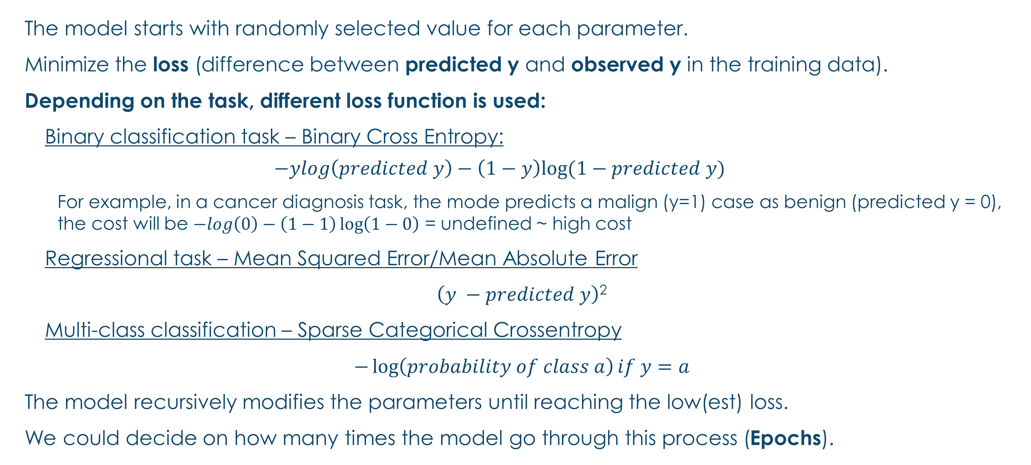
How is the neural network trained? (Optional) Loss function
Loss function
The model starts with randomly selected value for each parameter.
Minimize the loss (difference between predicted y and observed y in the training data).
Depending on the task, different loss function is used:
Binary classification task – Binary Cross Entropy:
$$−ylog\left(predicted y\right)−\left(1−y\right)log⁡(1−predicted y)$$
For example, in a cancer diagnosis task, the mode predicts a malign (y=1) case as benign (predicted y = 0), the cost will be $−log\left(0\right)−\left(1−1\right)\log\left(1−0\right)$ = undefined ~ high cost
Regressional task – Mean Squared Error/Mean Absolute Error
$\left(y −predicted y\right)$²
Multi-class classification – Sparse Categorical Crossentropy
$−\log\left(probability of class a\right)if y=a$
The model recursively modifies the parameters until reaching the low(est) loss.
We could decide on how many times the model go through this process (Epochs).
https://www.tensorflow.org/api_docs/python/tf/keras/losses
Notes:
Loss function measures how accurate the model is during training. You want to minimize this function to "steer" the model in the right direction. Loss function is average across cost of all cases.
Students do not need to know the loss function equation.
1 Epochs mean one round that the algorithms go through all the training case

Slide 21
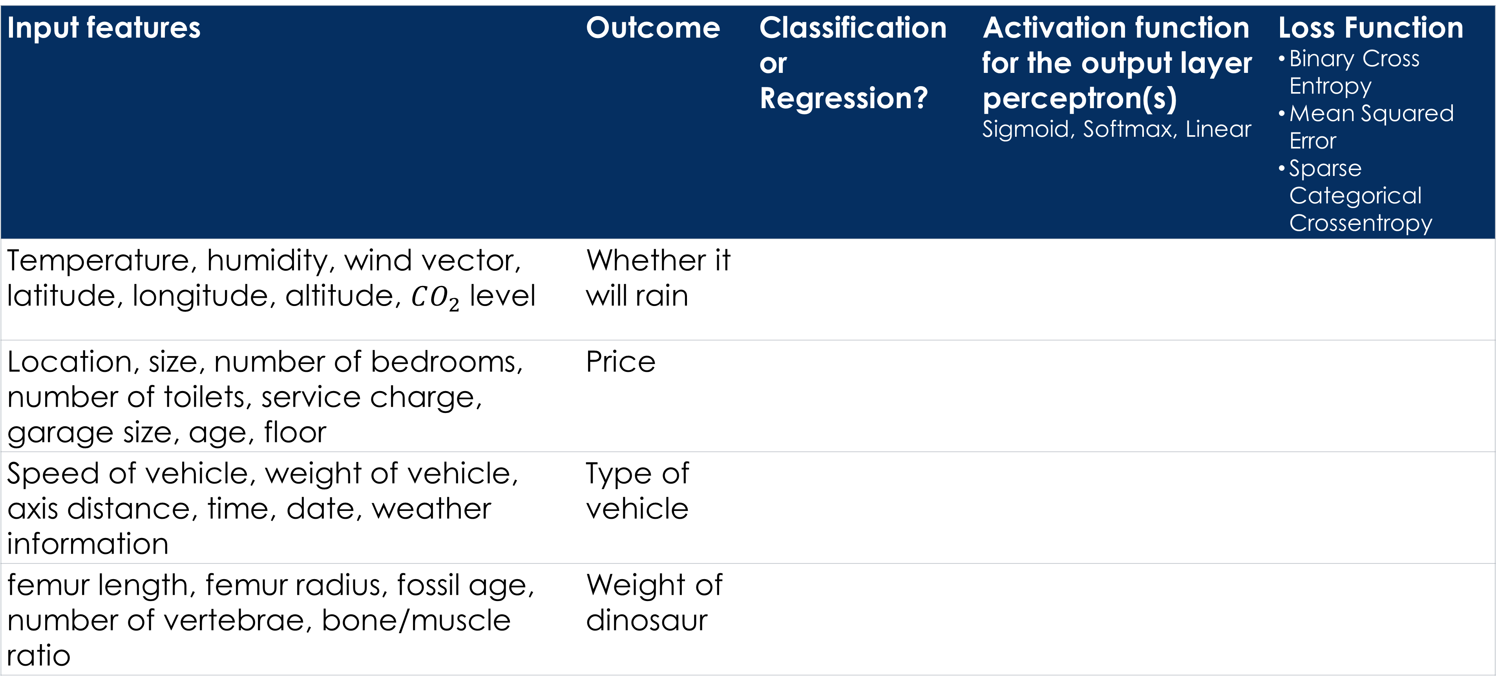
What to use?
Summary
Can you think of a machine learning task you plan to do with neural network?
Input features | Outcome | Classification or Regression? | Activation function for the output layer perceptron(s) Sigmoid, Softmax, Linear | Loss Function Binary Cross Entropy Mean Squared Error Sparse Categorical Crossentropy
Temperature, humidity, wind vector, latitude, longitude, altitude, $CO_{2}$ level | Whether it will rain
Location, size, number of bedrooms, number of toilets, service charge, garage size, age, floor | Price
Speed of vehicle, weight of vehicle, axis distance, time, date, weather information | Type of vehicle
femur length, femur radius, fossil age, number of vertebrae, bone/muscle ratio | Weight of dinosaur

Slide 22
What do you have to decide for neural network? Hyperparameters
Summary
Number of layers: start from 1 or 2 layers. Larger networks normally perform better but risk overfitting.
Number of perceptron/neurons/units/ in each layer: Typically, the number is similar to the number of input features.
Activation functions for each hidden layer: ReLU, Tanh, Sigmoid
Activation functions for output layer:
Sigmoid for binary/multilabel classification
Softmax for multiclass classification
Linear for regressional task
https://www.tensorflow.org/api_docs/python/tf/keras/activations
Loss function for training:
Binary Cross Entropy for Binary classification task
Mean Squared Error for Regressional task
Sparse Categorical Crossentropy for Multi-class classification
https://www.tensorflow.org/api_docs/python/tf/keras/losses
Other hyperparameters:
Learning rate – 0.001
Optimizer - Adam
Epochs – large number of training risks overfitting as the model memorises the training data
50 - 100
Notes:
learning rate, often noted �α or sometimes �η, indicates at which pace the weights get updated.
Optimizer is how the model is updated based on the data it sees and its loss function.

Slide 23
Implementation in Python
Implementation
In this session, we are using tensorflow
https://www.tensorflow.org/
https://www.tensorflow.org/install
Google Colab https://colab.research.google.com/
Beside tensorflow, you could also implement supervised neural network with
https://pytorch.org/
Scikit learn neural network, https://scikit-learn.org/stable/modules/neural_networks_supervised.html#
SPSS (premium subscription required)
If you would like to run on your own machine, please use Python 3.8–3.11
The latest python 3.12 on windows does not yet support tensorflow, so you may have to install Python 3.11. You could have more than one edition of Python on your machine.
Notes:
In this course, we use tensor, but feel free to explore other framework like pytorch
Give students time to install? Or can we ask students to install beforehand?

Slide 24
General workflow
Summary
Pre-processing
Split to training and test data
Normalisation
Construct the neural network
Specify the number of layers, units, activation function
Specify the loss function, learning rate and optimizer
Train the model
Specify epochs
Evaluate the model
Apply to new unseen data
Scikit learn
Tensorflow
Tensorflow
Scikit learn

Slide 25

Predicting activity from sensor data
Demo
4429 sensor data sampled from accelerometer and gyroscope collected from iPhone 5c located on both left and right wrist in 10 seconds interval and 5.4/second frequency.
7 Features (X):
Wrist: 0 (left), 1 (right)
acceleration_x, acceleration_y, acceleration_z
gyro_x, gyro_y, gyro_z
Target (y): activity
0: 2202 walking
1: 2227 running
Image source: The Independent
Complete data from https://www.kaggle.com/datasets/vmalyi/run-or-walk

Slide 26
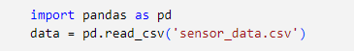
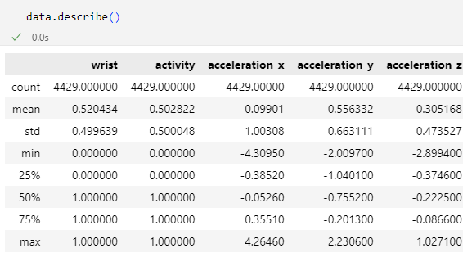
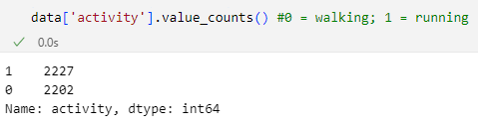
Loading and inspecting data
Demo
Importing data
Inspecting data

Slide 27
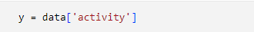


Creating X, y
Demo
Creating y
or
Creating X
Notes:
Change

Slide 28
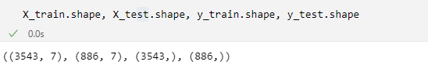
Pre-processing Split to training and test data
Demo
Sometimes, we also further create one more dataset for validation.
To examine the number of training data and test data after the split.

Slide 29
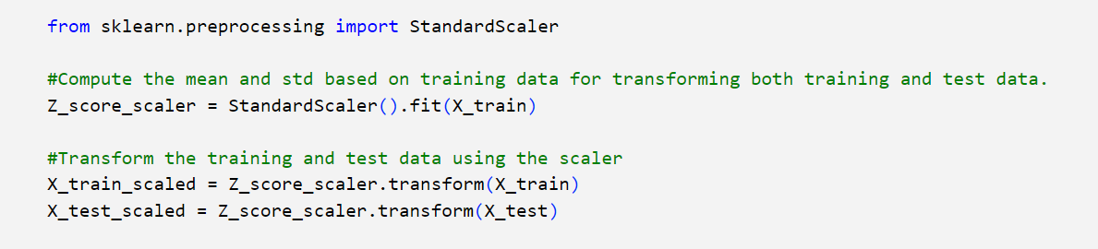
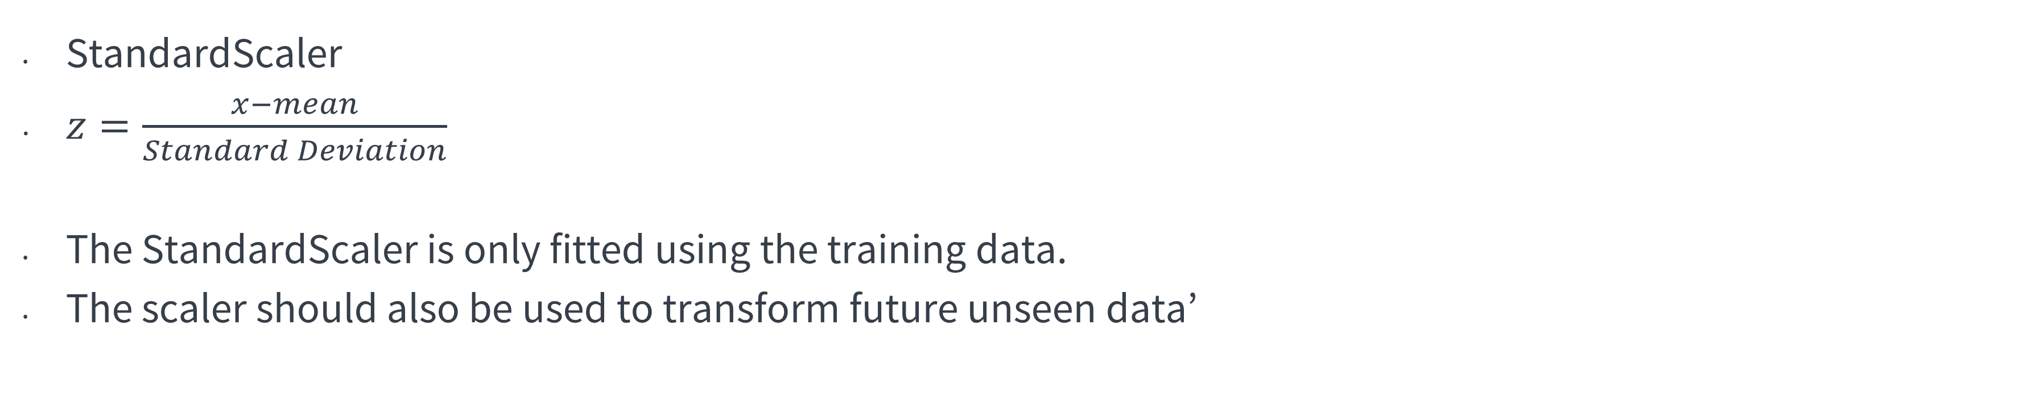
Normalisation
Demo
StandardScaler
$z=\frac{x−mean}{Standard Deviation}$
The StandardScaler is only fitted using the training data.
The scaler should also be used to transform future unseen data’
Notes:
The standard score of a sample x is calculated as:
z = (x - u) / s

Slide 30
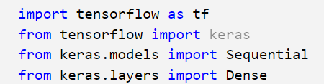
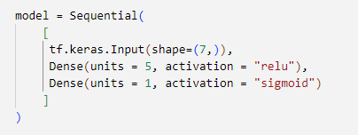







Construct the neural network Specifying the neural network layers, units and activation function
Demo
$$X_{5}^{}$$
Input layer
$$X_{2}^{}$$
$$X_{4}^{}$$
$$X_{6}^{}$$
$$X_{3}^{}$$
$$X_{1}^{}$$
$$X_{7}^{}$$
Hidden layer 1
Output Layer
Notes:
Each Dense line corresponds to one layer, in which we specify number of units/perceptron, activation function. In this example, there are 2 hidden layers and one output layer.
Activation function for the hidden layer (the first two here) typically are non-linear, while the output layer (the last one here) depends on whether the problem is (binary) classification/regression.
Input layer specification is optional

Slide 31
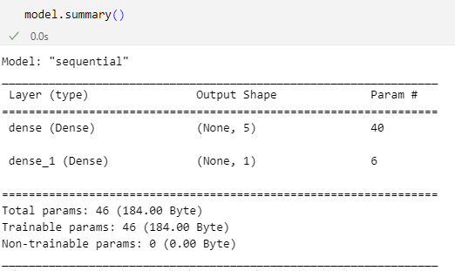







The neural network architecture
Demo
$$X_{5}^{}$$
Input layer
$$X_{2}^{}$$
$$X_{4}^{}$$
$$X_{6}^{}$$
$$X_{3}^{}$$
$$X_{1}^{}$$
$$X_{7}^{}$$
Hidden
layer 1
Output Layer

Slide 32
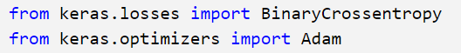
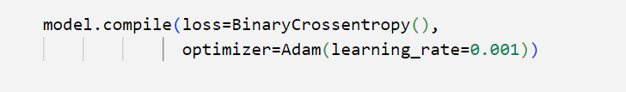
Construct the neural network Specify the loss function, learning rate and optimizer
Demo
Loss:
BinaryCrossentropy() for binary classification problems
MeanSquaredError() for regressional problems
Optimizer: it is to help with faster training, typically we use Adaptive moment estimation
https://keras.io/api/optimizers/adam/
Notes:
Adam = Adaptive Moment estimation, dynamically change the learning rate behind the scene.

Slide 33
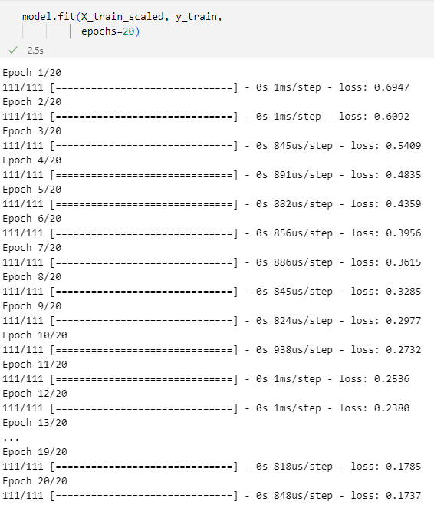
Train the model
Demo
Epochs: An epoch in machine learning means one complete pass of the training dataset through the algorithm.
Loss refers to how close the prediction is to the real value of y
Notice the decreasing loss after each epoch.

Slide 34
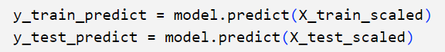
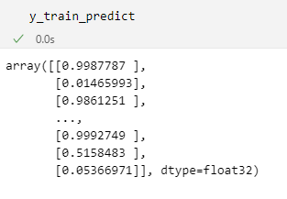
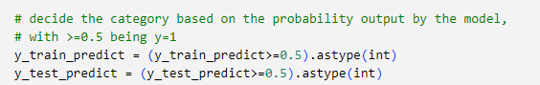
Evaluate the model
Demo
Sigmoid
Use probability to decide class
Notes:
Not necessarily 0.5, on assumption that equal split, although our data shows a 0.62 ratio
classification threshold (also called the decision threshold).

Slide 35
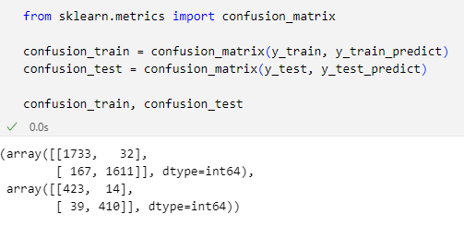
Evaluate the model
Demo
Predicted y = 0
Predicted y = 1
 | Class1 | Class 2
Class1 | True Positive | False Negative
Class 2 | False Positive | True Negative
Predicted
y = 0
y = 1
Notes:
Remind students the sklearn confusion matrix go by the lowest first and why the data code 0 for the malignant case

Slide 36
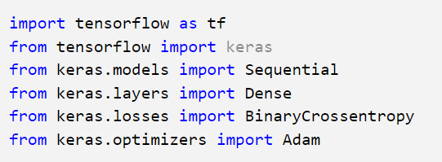
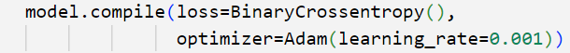
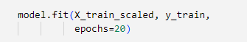
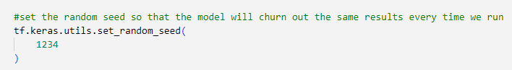
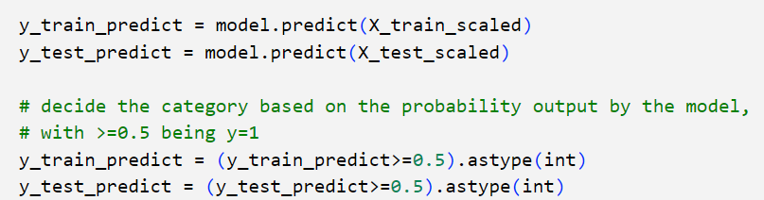
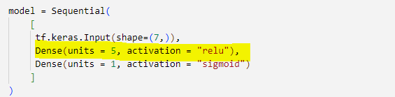
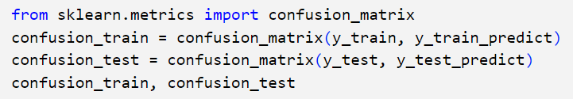
Now lets’ see if you can beat my model… Create a model with different hyperparameters (number of neurons or hidden layers) to compare and note down the confusion matrix
Hands-on
Importing required library and functions
Specify the training loss and optimizer
Fitting the model
Calculating the prediction based on the model
Specify the architecture of neural network
Evaluating the model
You can also add more hidden layers

Slide 37
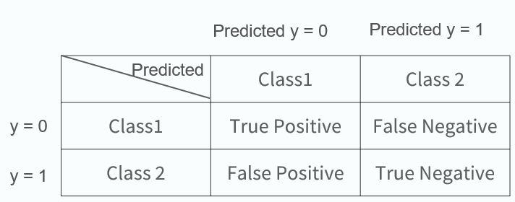
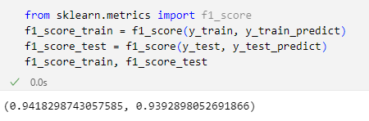
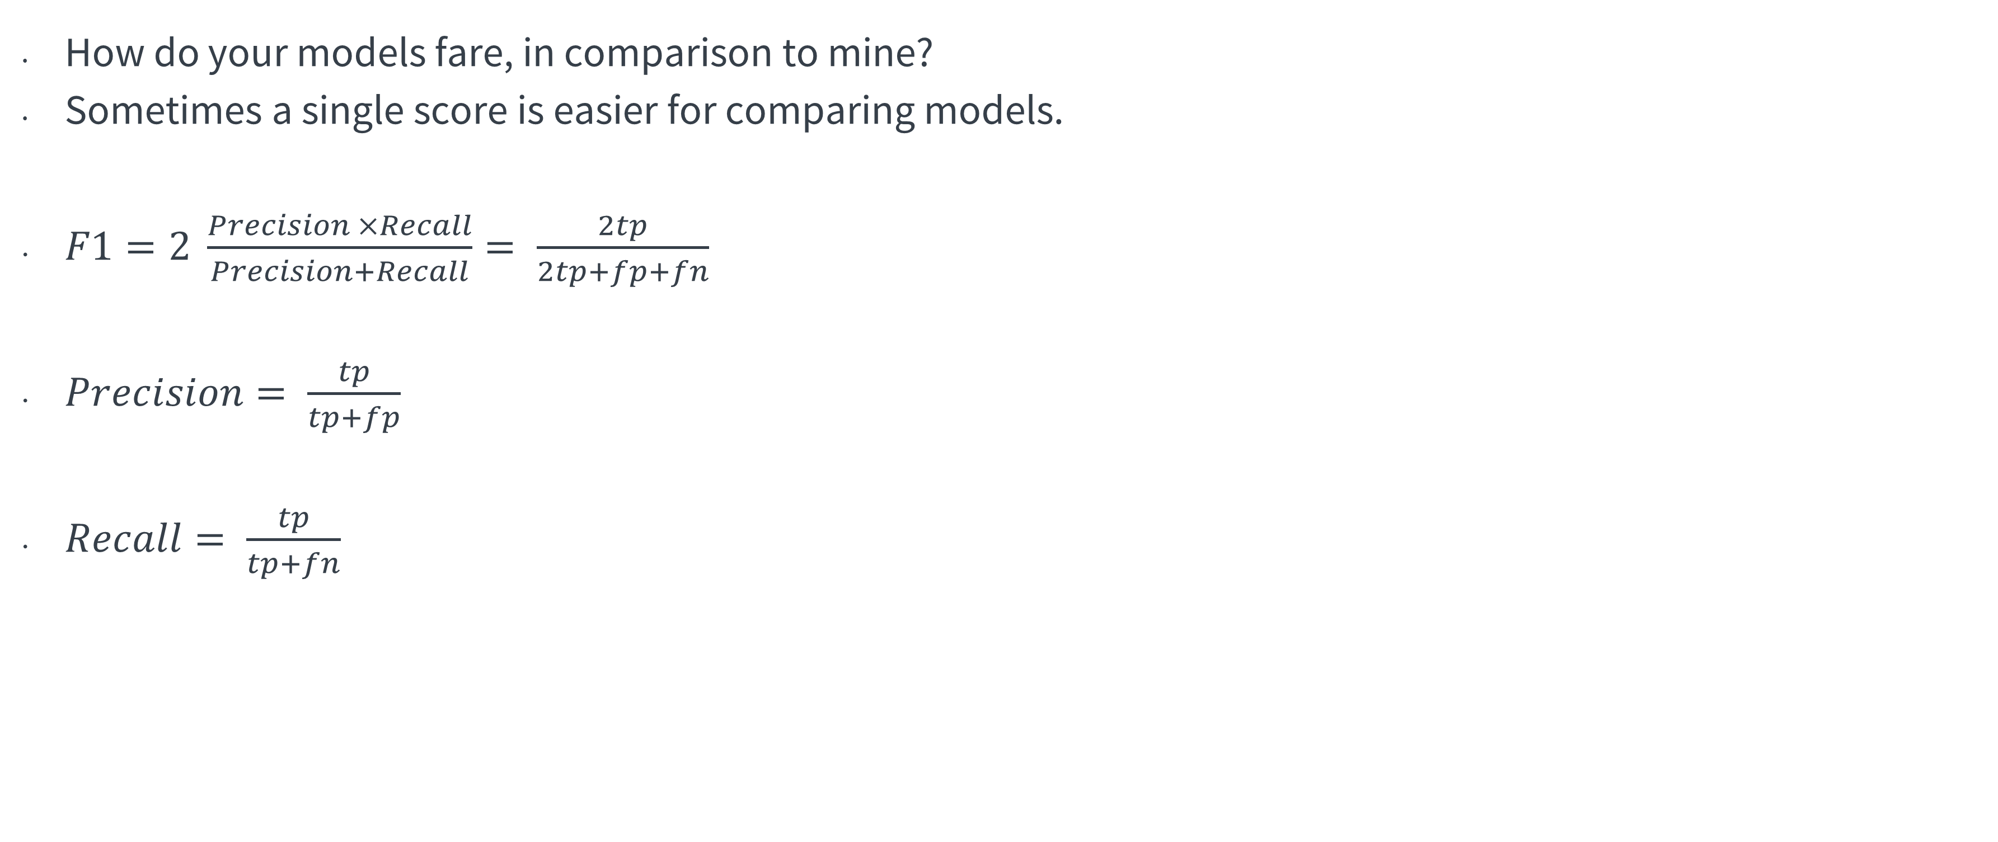
Confusion matrix vs. F1 score
Demo/
Hands on
How do your models fare, in comparison to mine?
Sometimes a single score is easier for comparing models.
$F1=2 \frac{Precision ×Recall}{Precision+Recall}= \frac{2tp}{2tp+fp+fn}$
$Precision= \frac{tp}{tp+fp}$
$Recall= \frac{tp}{tp+fn}$
Among those we predict as positive, how many are truly positive.
Among those which are truly positive, how many do we pick up.
Let’s try to use this score now to compare your model to mine.
Notes:
F1 is like an average score that take into account all these measures
Ask the students to try

Slide 38
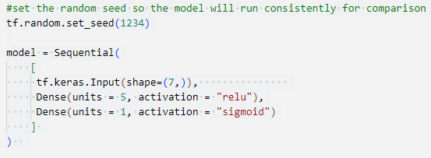



Using F1 score to choose/compare models
Demo
1-hidden-layer model
2-hidden-layer model
Notes:
Let the learners know sometimes it won’t be that high score

Slide 39



Multi-class classification (Optional) different way of implementation
Implementation
Due to some computational issues, for multiclass classification, it is recommended to implement the output layer and loss in a different way from what we have been implementing.
Notes:
Recall from lecture, more stable and accurate results can be obtained if the softmax and loss are combined during training. This is enabled by the 'preferred' organization shown here.
In the preferred organization the final layer has a linear activation. For historical reasons, the outputs in this form are referred to as *logits*. The loss function has an additional argument: `from_logits = True`. This informs the loss function that the softmax operation should be included in the loss calculation. This allows for an optimized implementation.

Slide 40
Considerations
Summary
Explanability: Hard to know the relative impact/importance of each feature.
Features:
ANN can only work with numbers, so we need to preprocess data into numeric.
Accuracy:
Although accuracy in computer vision, speech recognition etc has been promising, perfectly modelling human behaviour in social sciences might be harder.
Satisfying accuracy and error rate depends on the tasks.
Model complexity:
Large amount of data are required for good performance.
Hard to decide on hyperparameters.
Run multiple models with different values for the hyperparameters, pick the one with the best performance metrics (high F1 score, low mean square error)
If there are similar works in the literature, you could also model after them for these hyperparameters
Start from a simple model and slowly build up your model, and decent number of epochs.
Complex models can result in overfitting. Sometimes parsimonious modelling (Linear/Logistic regression or Decision Trees) can achieve better results.
Notes:
Explanability, although we can breakdown the network to see the output of each neuron if we want to
Typically we expect deep learning to be an attractive choice when the
sample size of the training set is extremely large, and when interpretability
of the model is not a high priority.

Slide 41


Overfitting: (optional) Regularisation and dropout
Overfitting
Overfitting: Training accuracy is high while testing accuracy is low.
Complex model, i.e., multiple layers of hidden layers with multiple neurons, such that the model can ‘memorise’ the training data, but could not generalise to unseen data.
Solution 1: Regularisation
Reduce the influence of parameters of a particular layer

Slide 42



Solutions to overfitting: (Optional)
Overfitting
Solution 2: Dropout
Randomly take away some perceptrons in a layer

Slide 43

Solutions to overfitting: (Optional)
Overfitting
Combining the two solutions:
https://www.tensorflow.org/tutorials/keras/overfit_and_underfit

